Slide 1
Chapter 22
Database Access with ADO.NET.

Slide 2
Objectives
.NET Data Providers
Two distinct ways to interface with a data source
  Connected layer and
  Disconnected layer
Role of connection objects, command objects, data readers, data adapters

Slide 3
Content
Introduction to ADO.NET
Understanding ADO.NET Data Providers
Understanding the Connected layer of ADO.NET
Working with Data Readers
Modifying tables using Command objects.
Working with Parameterized Command objects
Executing a Stored Procedure using DbCommand

Slide 4
Content
Understanding the Disconnected Layer of ADO.NET
Understanding the role of the DataSet
Working with DataColumns
Working with DataRows
Working with DataTables
Working with the DataView Type
Working with Data Adapters
Updating a Database Using Data Adapter Objects
Autogenerating SQL Commands Using CommandBuilder Types

Slide 5
Introduction to ADO.NET
Two conceptually unique manners
  Connected layer:
    explicitly connect to and disconnect from the underlying data store
    using Connection, Command, and Data reader objects
  Disconnected layer:
    obtain client-side copy of the external data
    the connection is automatically opened and closed
    using Data Adapter, DataSet, and DataTable

Slide 6
Understanding ADO.NET Data Providers
ADO.NET does not provide a single set of types that communicate with multiple database management systems (DBMSs)
Rather, ADO.NET supports multiple data providers, each of which is optimized to interact with a specific DBMS
Benefits:
  A specific data provider can be programmed to access any unique features of the DBMS.
  A specific data provider is able to directly connect to the underlying engine of the DBMS without an intermediate mapping layer standing between the tiers

Slide 7
Understanding ADO.NET Data Providers
A data provider is a set of types defined in a given namespace that understand how to communicate with a specific data source.
Core common objects:
  Connection: provides the ability to connect to and disconnect from the data source
  Command: represents a SQL query or name of a stored procedure
  DataReader: provides forward-only, read-only access to data

Slide 8
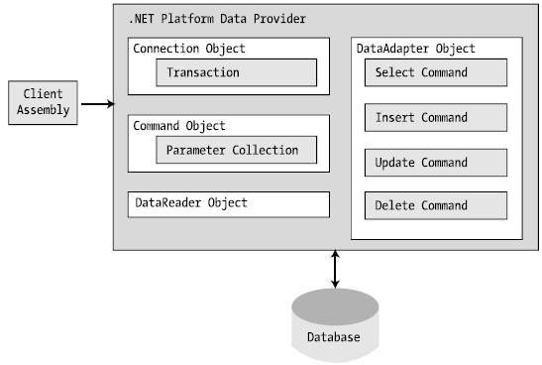
Understanding ADO.NET Data Providers
The big picture behind ADO.NET data providers

Slide 9
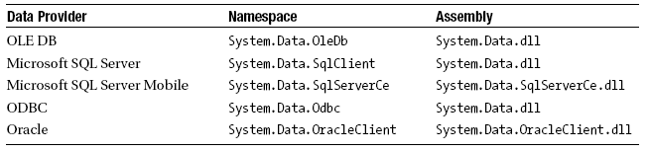
Understanding ADO.NET Data Providers
Microsoft-Supplied Data Providers
OLE DB is used for interacting with a DBMS that does not define a specific

Slide 10
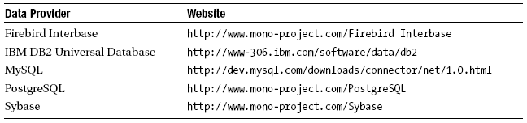
Understanding ADO.NET Data Providers
Third-Party Data Providers

Slide 11
Understanding the Connected Layer of ADO.NET
The connected layer of ADO.NET allows you to interact with a database using the connection, command, and data reader objects of your data provider
Steps to connect to a database and read the records using a data reader object:
  Allocate, configure, and open your connection object
  Allocate and configure a command object, specifying the connection object as a constructor argument or via the Connection property
  Call ExecuteReader() on the configured command object.
  Process each record using the Read() method of the data reader

Slide 12
Understanding the Connected Layer of ADO.NET
Working with Connection objects
  Establish a session with the data source
  Formatted connection string: contains a number of name/value pairs separated by semicolons
    the name of the machine
    the name of the database on that machine
    required security settings
    and other data provider–specific information.

Slide 13
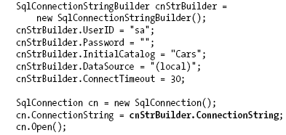
Understanding the Connected Layer of ADO.NET
Working with ConnectionStringBuilders
  Allow to establish the name/value pairs using strongly typed properties

Slide 14
Understanding the Connected Layer of ADO.NET
Working with Command objects
  is an OO representation of a SQL query, table name, or stored procedure
  The type of command is specified using the CommandType property, which includes:
    StoredProcedure,
    TableDirect,
    Text // Default value.

Slide 15
Understanding the Connected Layer of ADO.NET
Working with Command objects
  ExecureReader(), returns the data provider’s DataReader object
  ExecureNonQuery(), issues the command text to the data store
  ExecureScalar(): is designed specifically for singleton queries
  ExecureXmlReader(): returns a System.Xml.XmlReader that allows to process the incoming stream of XML

Slide 16
Working with Data Readers
Is the simplest and fastest way to obtain information from a data store
Represents a read-only, forward-only stream of data returned one record at a time
Is useful when you need to iterate over large amounts of data very quickly and have no need to maintain an in-memory representation
Maintains an open connection to their data source until you explicitly close the session

Slide 17
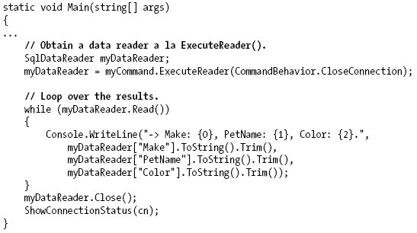
Working with Data Readers
Call Close() as soon as you are finished processing the records

Slide 18
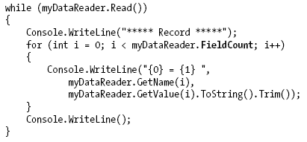
Working with Data Readers
User indexer of a data reader object

Slide 19
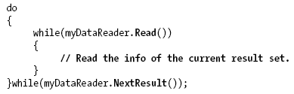
Working with Data Readers
Obtaining Multiple Result Sets Using a Data Reader
  specify both SQL select statements using a semicolon delimiter:
  iterate over each result set via the NextResult() method:

Slide 20
Modifying tables using Command objects
The ExecuteReader() method extracts a data reader object using a forward-only, read-only flow of information
The ExecuteNonQuery() method of command object will perform inserts, updates, and deletes based on the format of command text.

Slide 21
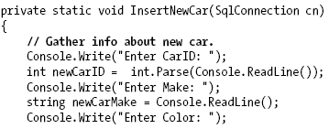
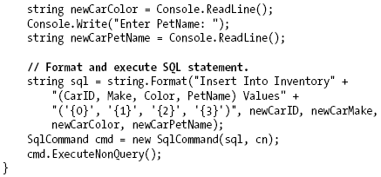
Modifying tables using Command objects
Inserting new records

Slide 22
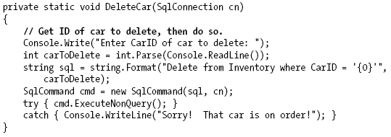
Modifying tables using Command objects
Deleting existing records

Slide 23
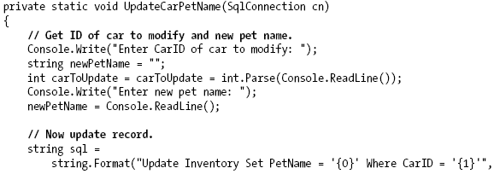

Modifying tables using Command objects
Updating existing records

Slide 24
Working with Parameterized Command objects
Building a SQL statement using string concatenation can be risky from a security point of view (think: SQL injection attacks)
Parameterized queries execute much faster than a literal SQL string, in that they are parsed exactly once
To associate a parameter within a SQL query to a member in the command object’s parameters collection, prefix the SQL text parameter with an at (@) symbol

Slide 25
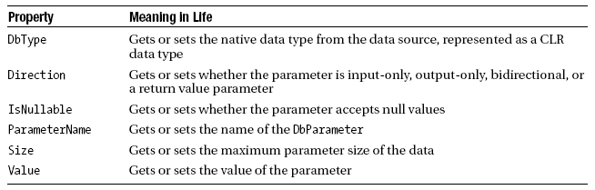
Working with Parameterized Command objects
Key Members of the DbParameter Type

Slide 26
Executing a Stored Procedure Using DbCommand
A stored procedure is a named block of SQL code stored in the database
Stored procedures can be constructed to return a set of rows or scalar data types and may take any number of optional parameters
The CommandText property is set to the name of the stored procedure. Must be sure to set the CommandType property to StoredProcedure
The Direction property of the parameter object allows you to specify input and output parameters

Slide 27
Understanding the Disconnected layer of ADO.NET
Use object named a data adapter to fetch and update data.
Data Adapter objects make use of DataSet objects to move data between the caller and data source
The DataSet type is a container for any number of DataTable objects, each of which contains a collection of DataRow and DataColumn objects

Slide 28
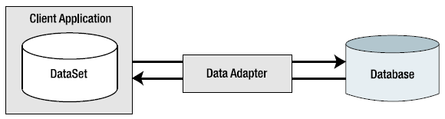
Understanding the Disconnected layer of ADO.NET
Data adapter objects move DataSets to and from the client tier
The data adapter handles the database connection automatically and keeps the connection open for the shortest possible amount of time

Slide 29
Understanding the Disconnected layer of ADO.NET
Once the caller receives the DataSet object, he is completely disconnected from the DBMS and left with a local copy of the remote data
The caller is free to insert, delete, or update rows from a given DataTable, but the physical database is not updated until the caller explicitly passes the DataSet to the data adapter for updating

Slide 30
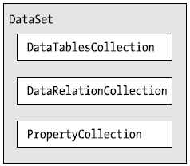
Understanding the role of the DataSet
A DataSet is an in-memory representation of external data.
A DataSet is a class type that maintains three internal strongly typed collections

Slide 31
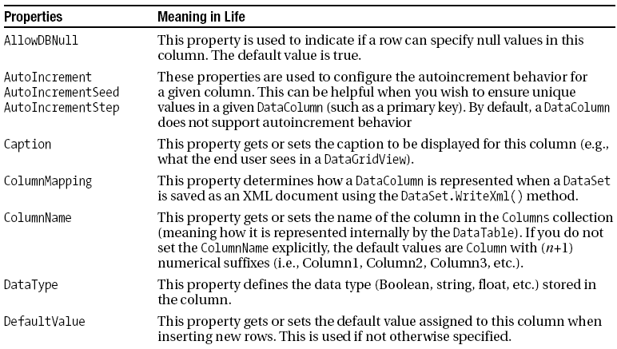
Working with DataColumns
The DataColumn type represents a single column within a DataTable
Properties of the DataColumn

Slide 32
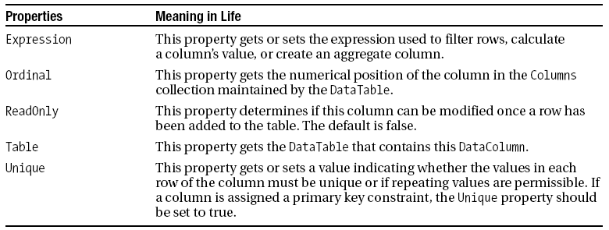
Working with DataColumns
Properties of the DataColumn

Slide 33
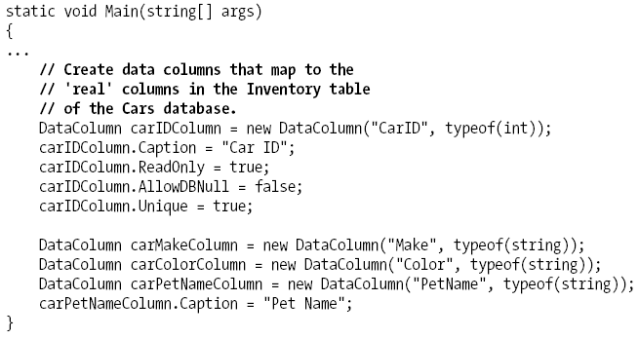
Working with DataColumns
Building a DataColumn

Slide 34

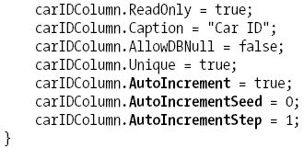
Working with DataColumns
Enabling auto-incrementing fields
  One aspect of the DataColumn you may choose to configure is its ability to autoincrement
  This behavior is controlled using the AutoIncrement, AutoIncrementSeed, and AutoIncrementStep properties

Slide 35
Working with DataRows
A collection of DataColumn objects represents the schema of a DataTable
A collection of DataRow types represents the actual data in the table
Using the members of the DataRow class, you are able to insert, remove, evaluate, and manipulate the values in the table

Slide 36
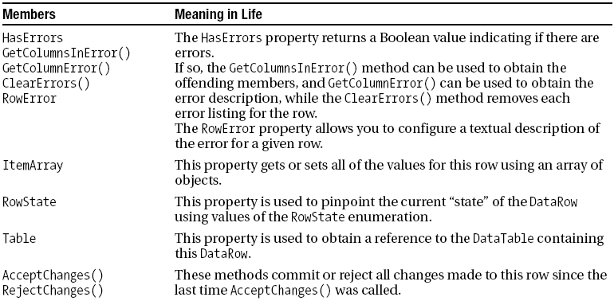
Working with DataRows
Key members of the DataRow type

Slide 37
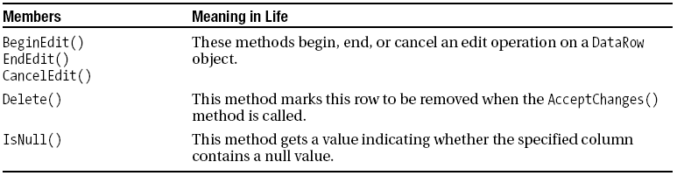
Working with DataRows
Key members of the DataRow type

Slide 38
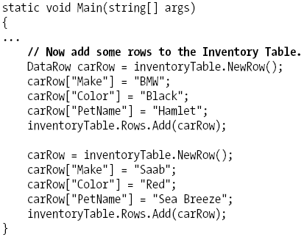
Working with DataRows

Slide 39
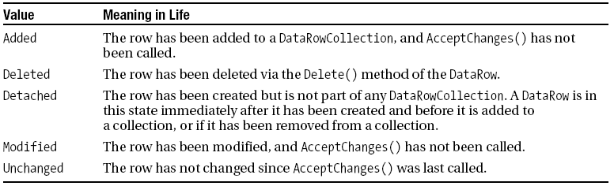
Working with DataRows
Understanding the DataRow.RowState Property
  is useful when need to identify the set of all rows in a table that have changed, have been newly inserted, and so forth

Slide 40
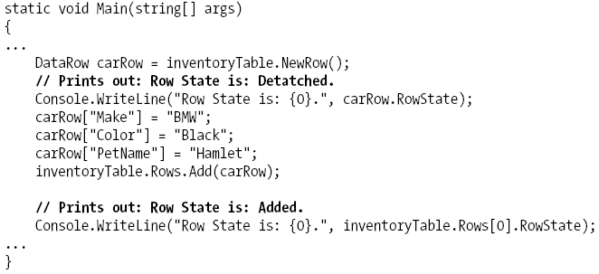
Working with DataRows
While you are programmatically manipulating the rows of a given DataTable, the RowState property is set automatically:

Slide 41
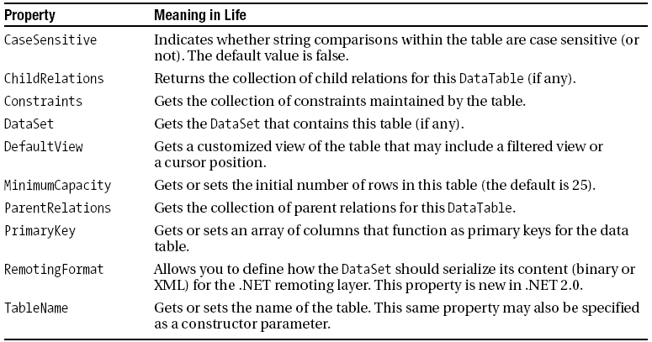
Working with DataTables
Key Members of the DataTable Type

Slide 42
Working with DataTables
Working with .NET 2.0 DataTableReaders
  DataTables also now support a method named CreateDataReader(), which allows you to obtain the data within a DataTable using a data reader–like navigation scheme (forward-only, read-only)

Slide 43
Binding DataTables to User Interfaces
Goal is to build a Form that displays the contents of a DataTable within a DataGridView widget
The DataGridView widget is the preferred UI control used to bind relational data

Slide 44
Working with the DataView Type
A view object is a stylized representation of a table (or set of tables)

Slide 45
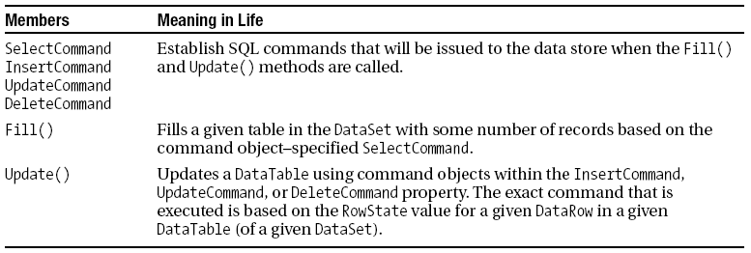
Working with Data Adapters
Core members of the DbDataAdapter class

Slide 46
Updating a Database using Data Adapter objects
When you call the Update() method of a given data adapter, it will
  examine the RowState property for each row in the DataTable
  use the correct SQL commands assigned to the DeleteCommand, InsertCommand, and UpdateCommand properties to push the changes within a given DataTable back to the data source

Slide 47
Autogenerating SQL Commands using Command Builder types
Be able to automatically obtain command objects that contain the correct Insert, Delete, and Update command types based on the initial Select statement
Conditions
  The Select command interacts with only a single table
  The single table has been attributed with a primary key
  The column(s) representing the primary key is accounted for in your SQL Select statement

Slide 48
Summary
Data access technology
How to select, update, insert, and delete records
How to bind data to Windows Forms controls

Slide 49
Q & A

